Slide 2
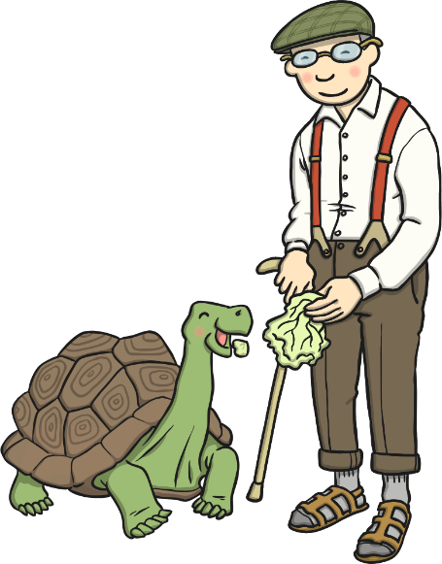
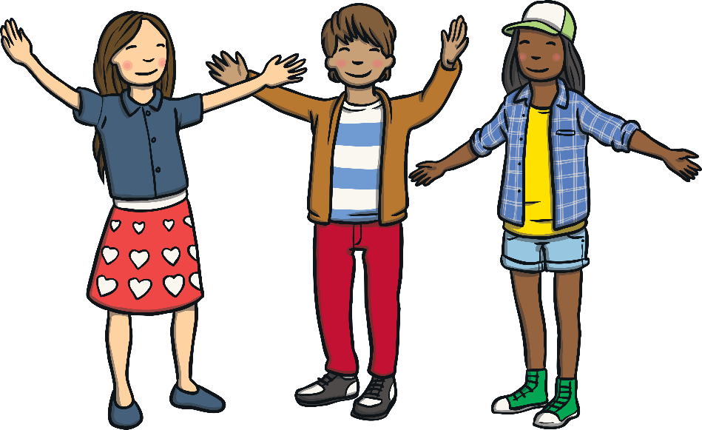
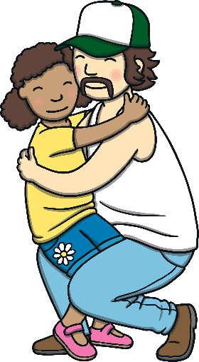
What Is Kindness?
Kindness is:
Being friendly
Looking after other people
Helping people
Being nice to others

Slide 3
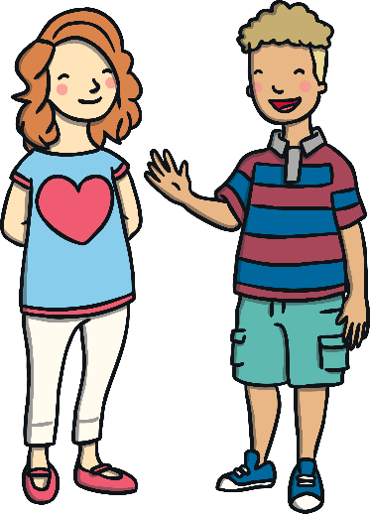
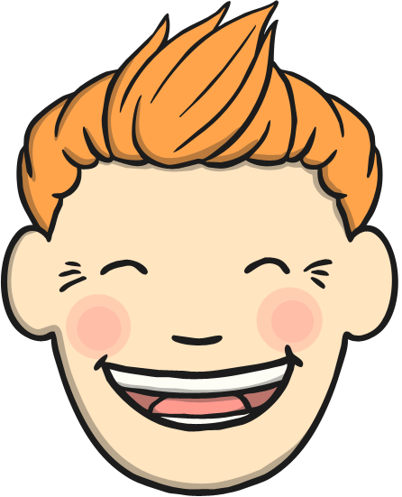
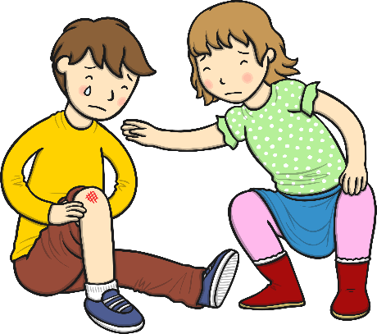
How Could You Show Kindness?
Smile at people.
Say hello and wave to people.
If somebody is upset, ask if they are ok.

Slide 4
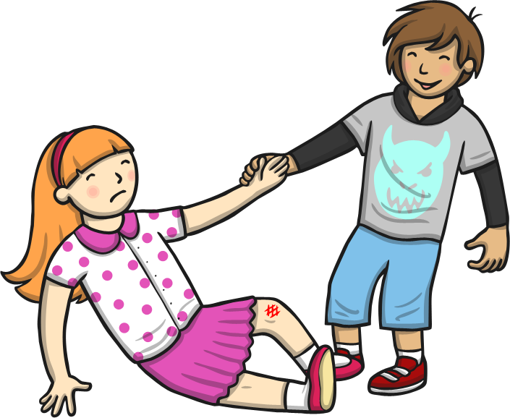
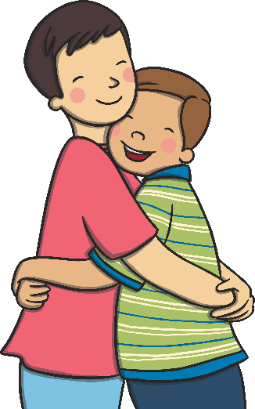
How Could You Show Kindness?
Help somebody up if they fall over.
Say hello and wave to people.
Give people a hug (if they want you to).

Slide 5

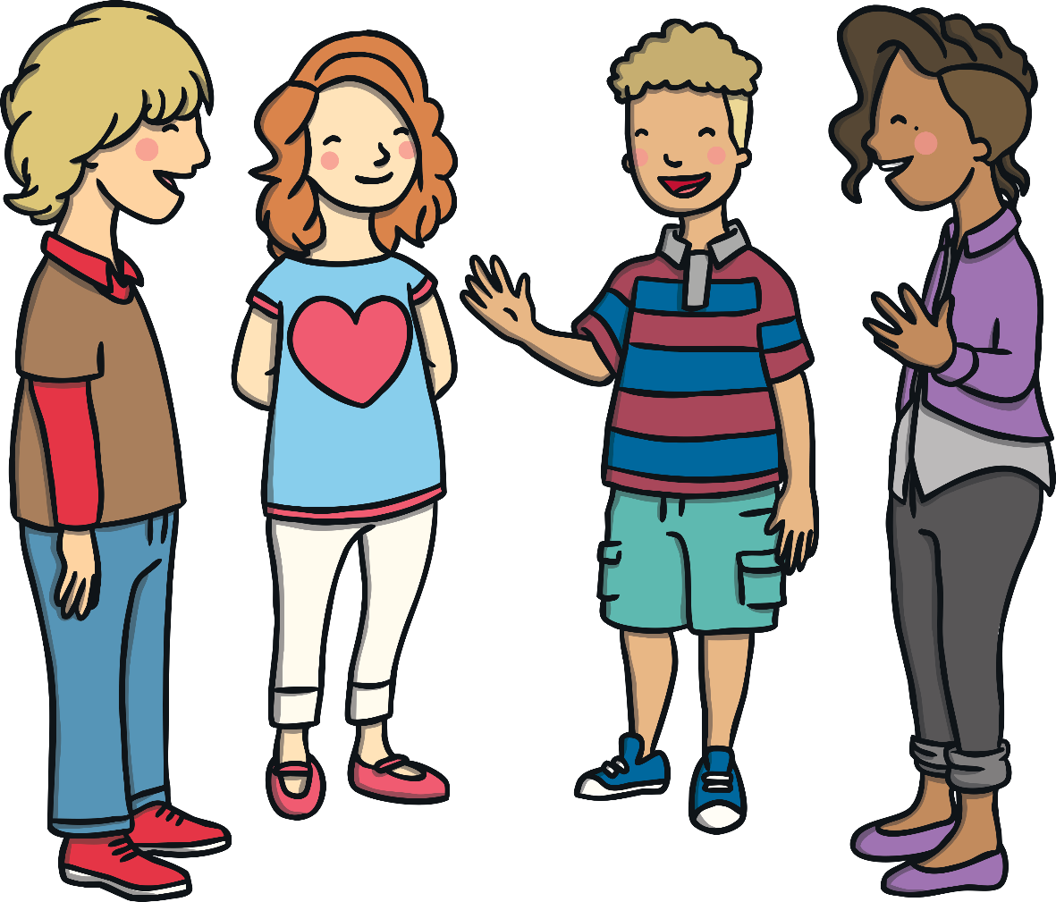
What Can You Do?
Tell a friend how to be kind.

Slide 6
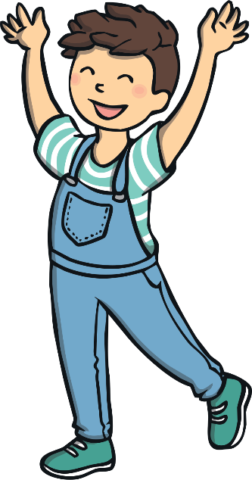
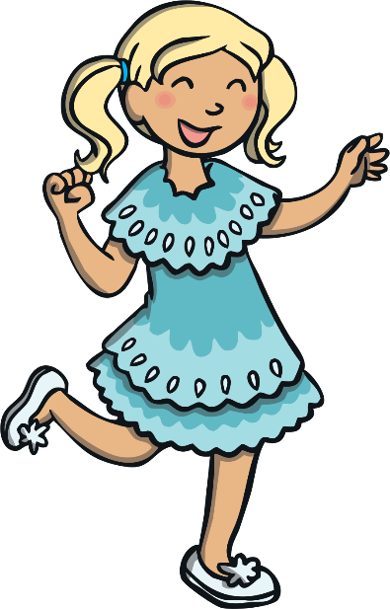
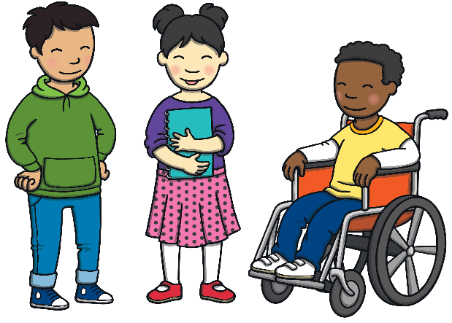
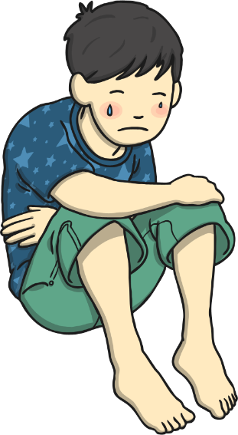
Why Is It Good to Be Kind?
It makes people feel happy.
It helps to make friends.
It stops people feeling upset.

Slide 7

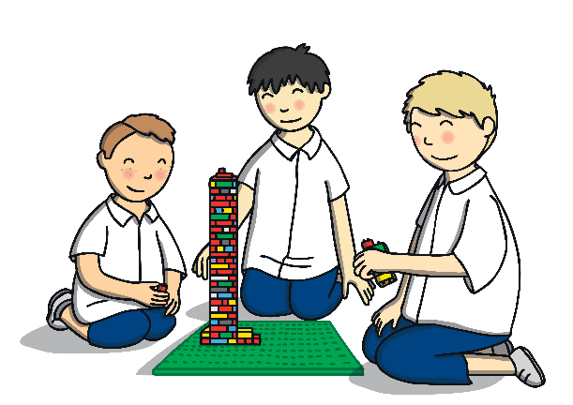

Think About It…
Have you been kind today?
Have you helped somebody?
What else have you done?

Slide 8
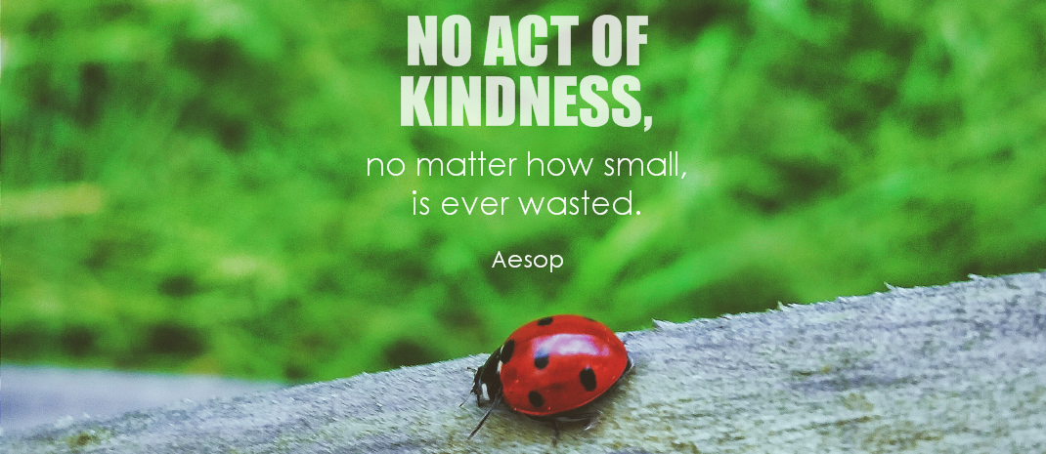
Kindness
Remember:
Always be kind to others.
If you are kind, people will be kind to you.
Photo courtesy of symphony of love (@flickr.com) - granted under creative commons licence – attribution

