Slide 1
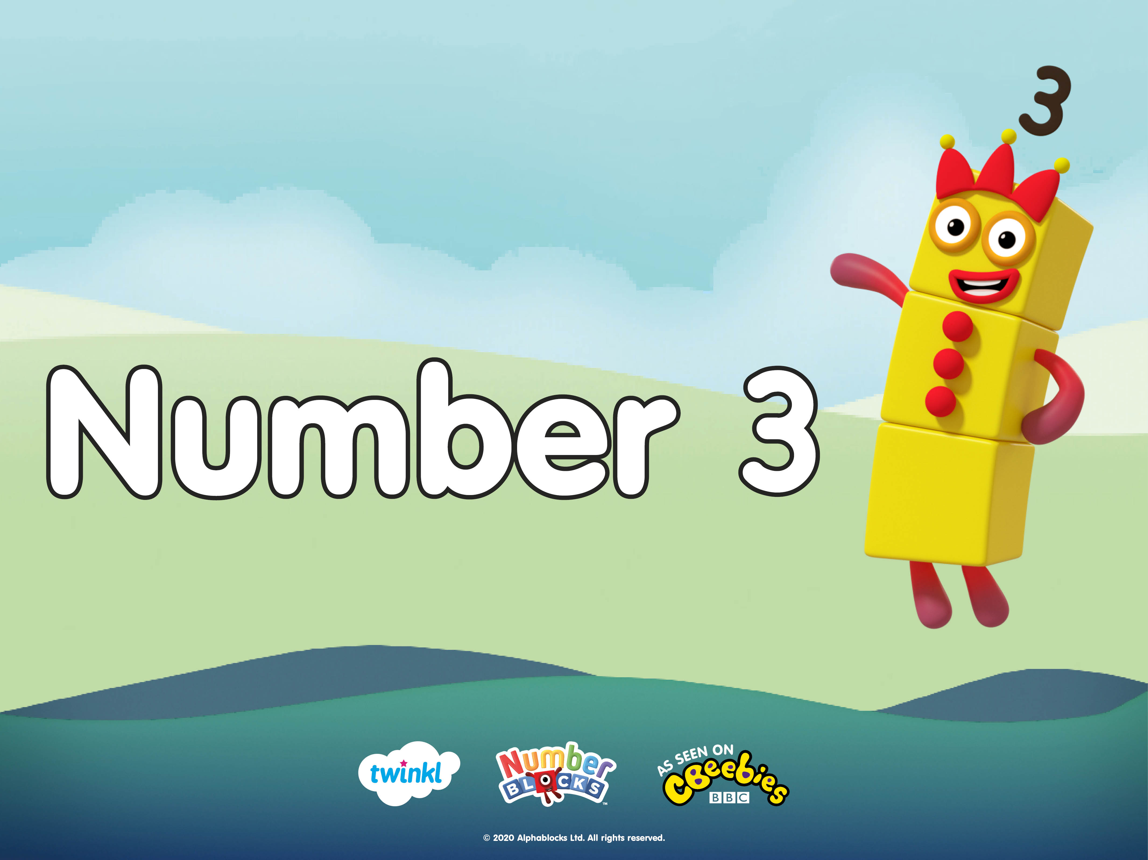

Slide 2










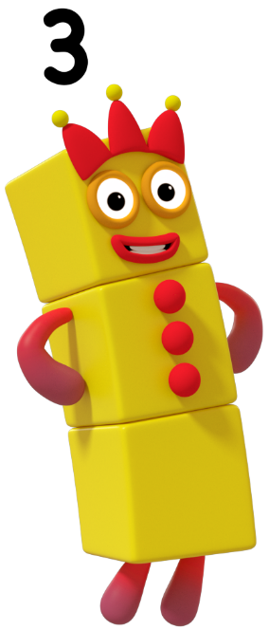


next
Click my magic hat to see my magic trick!
Can you count how many things I pull out of my hat?

Slide 3
next
How many books did I pull out of my hat?
Click my hat to check!

Slide 4
next
Click my magic hat to see my magic trick!
Can you count how many things I pull out of my hat?

Slide 5
next
How many juggling balls did I pull out of my hat?
Click my hat to check!

Slide 6
Let’s go on a 3 adventure!
Click my magic hat to hop into my magical storybook. Can you help me find and make 3?

Slide 7







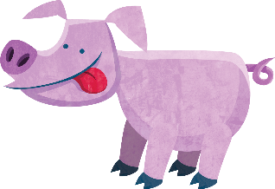


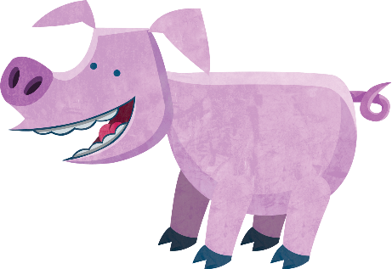

next
Can you see 3? Click me to continue.
“I can see…”

Slide 8
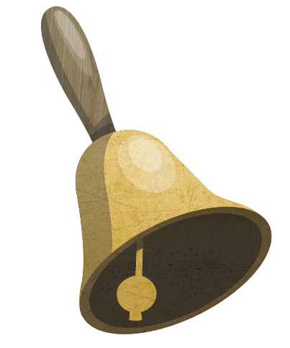
next
How many bells can you see? Can you show me on your fingers?
“I can see…”

Slide 9
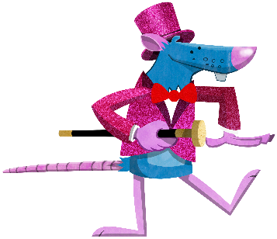
next
I need 1 more.
How many more mice do I need
to make 3? Click me to find out.
How many mice do you see?

Slide 10

next
I need 2 more.
How many loaves of bread do you see?
How many more loaves do I need
to make 3? Click me to find out.

Slide 11
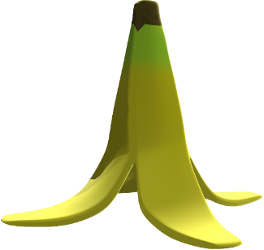

next
How many bananas can you see?
How many more do I need to make 3?
I need 1 more banana to make 3.

Slide 12

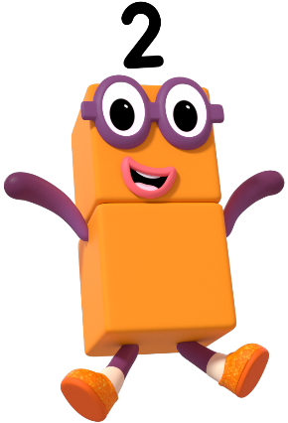
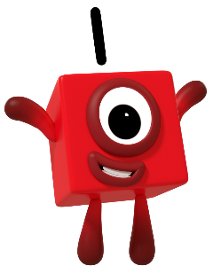
next
+
=
2 + 1 = 3

Slide 13


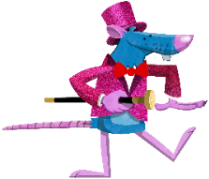



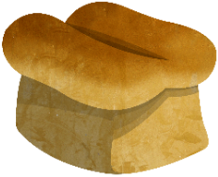


finish
Click on the circles to reveal the pictures. Can you talk about the things you saw 3 of? Say, “I saw 3...”

Slide 14
