Slide 2
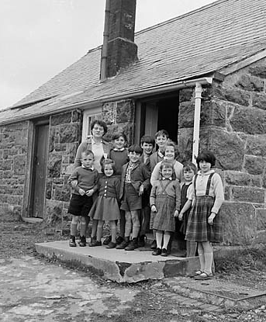
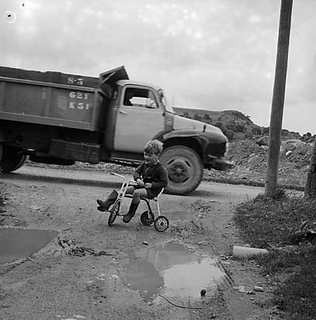
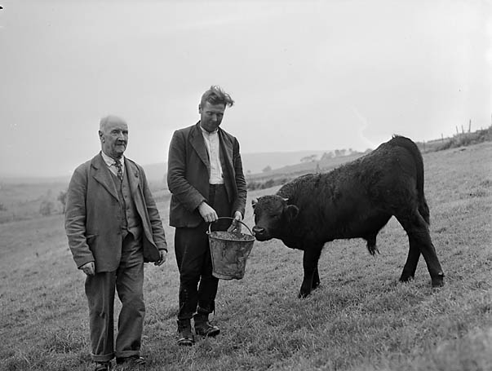
The Village of Capel Celyn
Generations of families had lived in a small village called Capel Celyn in the Tryweryn Valley in North Wales for many years.
It was a beautiful valley with one school, a post office, chapel, cemetery, farm houses and cottages. Everybody knew each other and it was a friendly Welsh community.

Slide 3
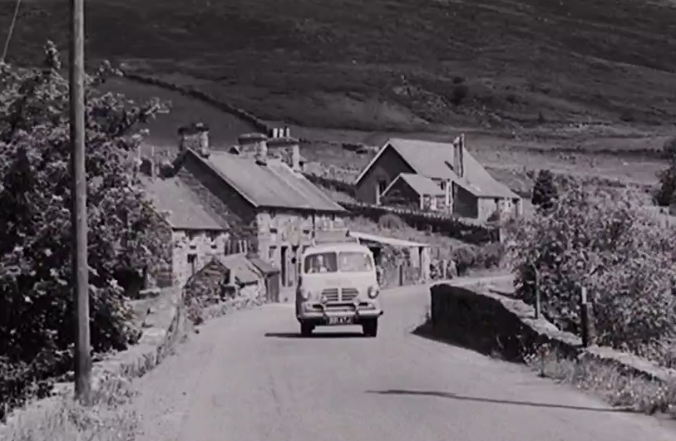
A Beautiful Rural Village

Slide 4
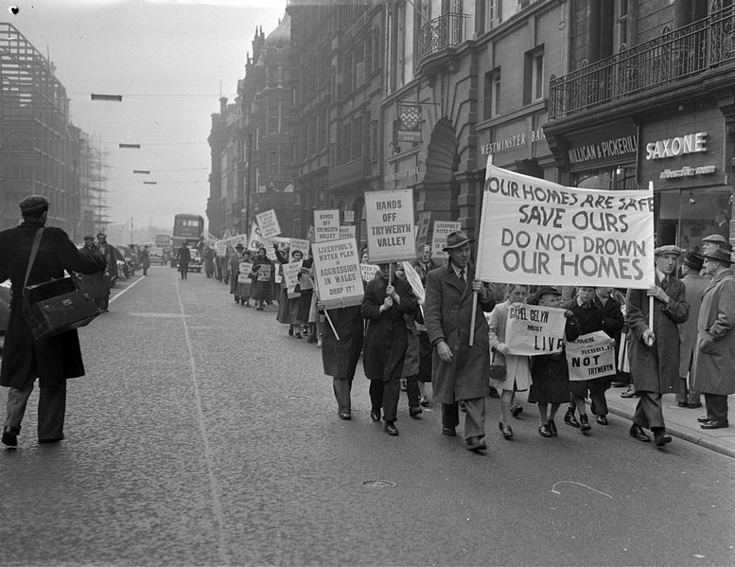
Shock from Liverpool
Generations of families had lived in a small village called Capel Celyn in the Tryweryn Valley in North Wales for many years.

Slide 5
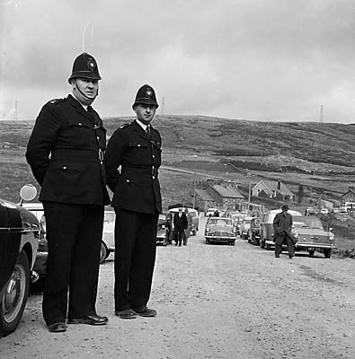
Destroying Capel Celyn
But despite the protestations, the demolition of the village and the building of the reservoir commenced. Families were broken hearted. As children walked to school they passed huge and noisy demolition machines, they heard the screaming of the trees as they were chopped down and fell to the floor.
As they sat in their school, their desks vibrated due to the heavy drilling machines outside.
Many journalists and photographers waited outside the school on the children’s last day to see them leaving for the last time.

Slide 6

More Protesting!
On the 22nd of September in 1962, David Pritchard and David Walter caused damage to the machines in an attempt to stop the building of the reservoir. They were arrested and fined £50.
In 1963 Emyr Llywelyn Jones, Owain Williams and John Albert Jones tried to stop the building of the reservoir by causing an explosion which caused damage. They were all jailed for 12 months.

Slide 7
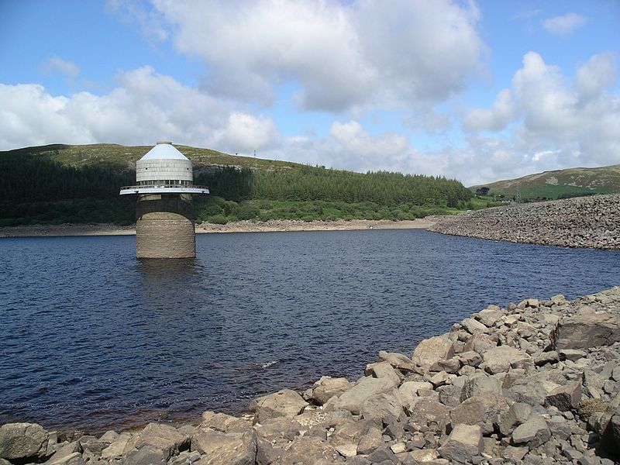
Leaving the Valley
70 people lost their homes, the valley emptied and the dam was completed. In 1965 the water came and drowned the valley. The people of Wales were angered, yet saddened to see 800 acers of land under water in order to provide Liverpool with water.

Slide 8
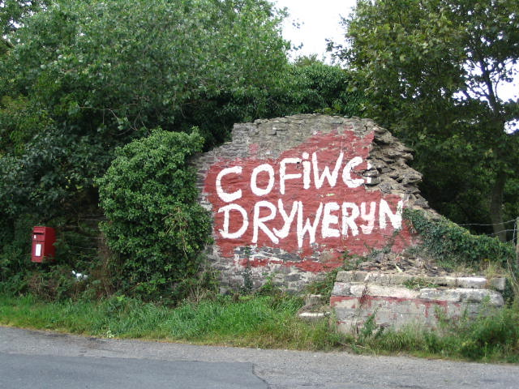
Apology
It was discovered that Liverpool city had not used the water to supply their City with water, but instead was selling the water to other counties in order to make profit.
In 2005, the Liverpool City Council officially apologised for
flooding Tryweryn.

Slide 9
Extra resources
https://www.youtube.com/watch?v=r2PGQhK4uYU
https://www.bbc.co.uk/news/uk-wales-politics-34533405
https://www.bbc.co.uk/programmes/b06jsxbk
https://www.youtube.com/watch?v=QvBxJEeU1GI

