Slide 1


Slide 2
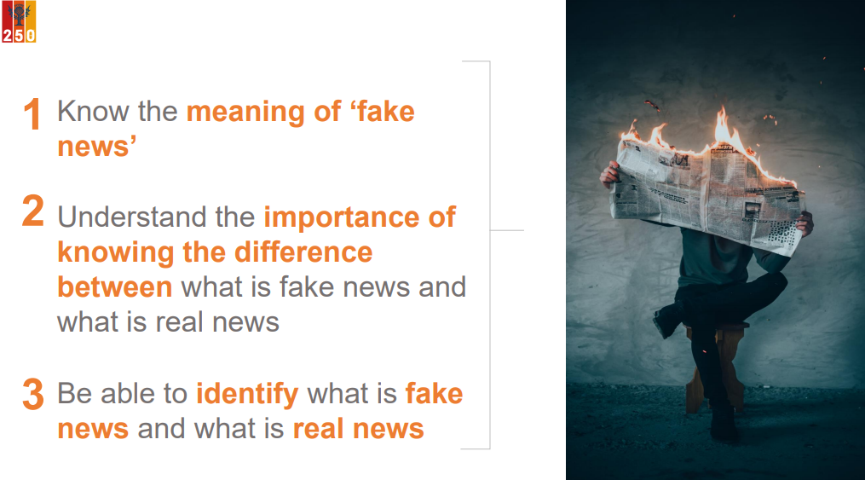

Slide 3
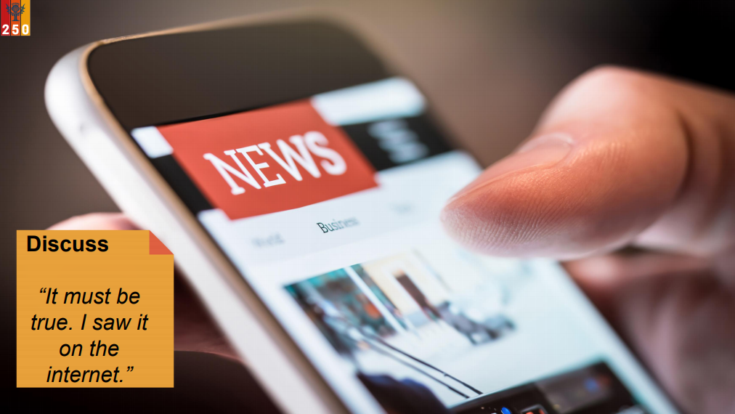

Slide 4


Slide 5


Slide 6
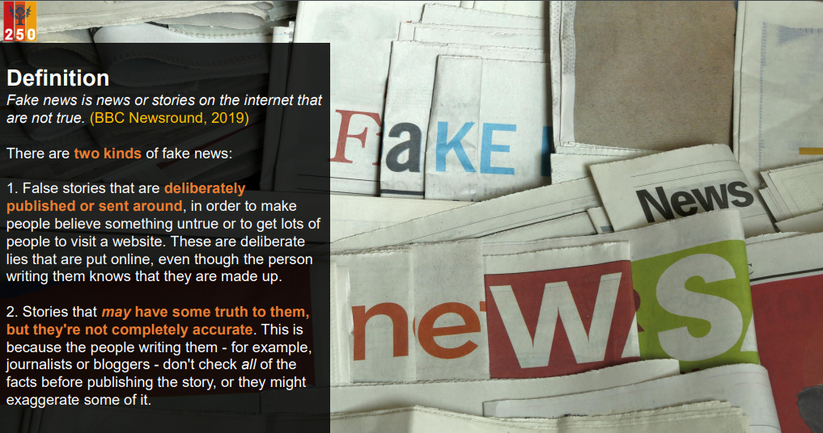

Slide 7
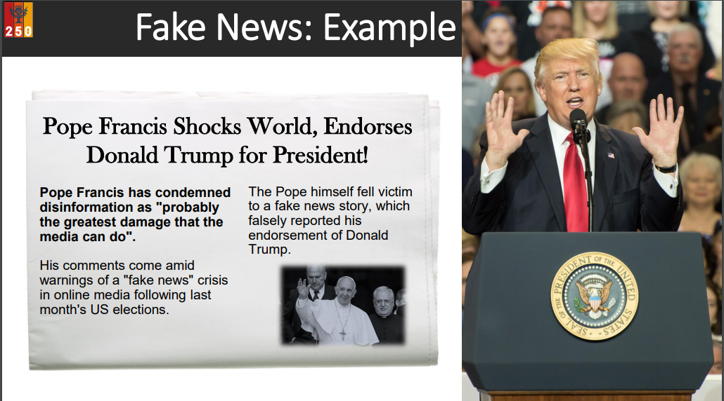

Slide 8
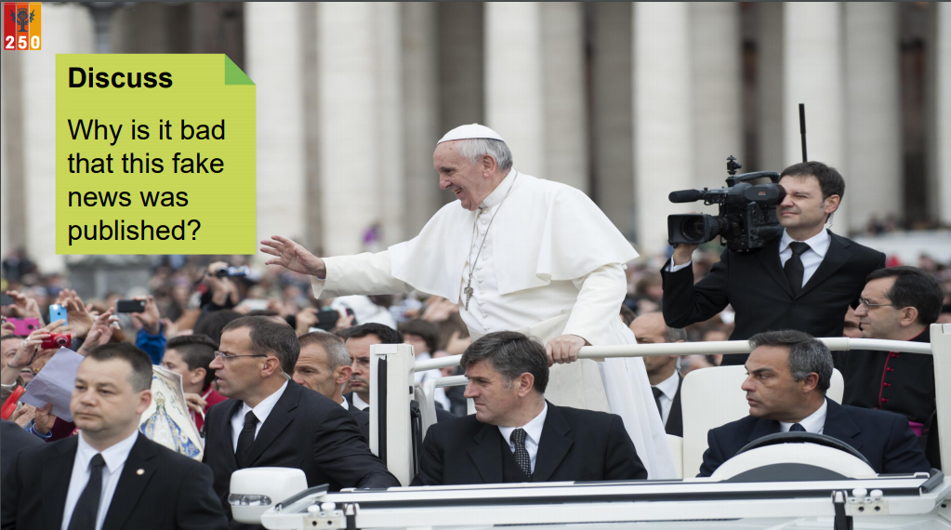

Slide 9
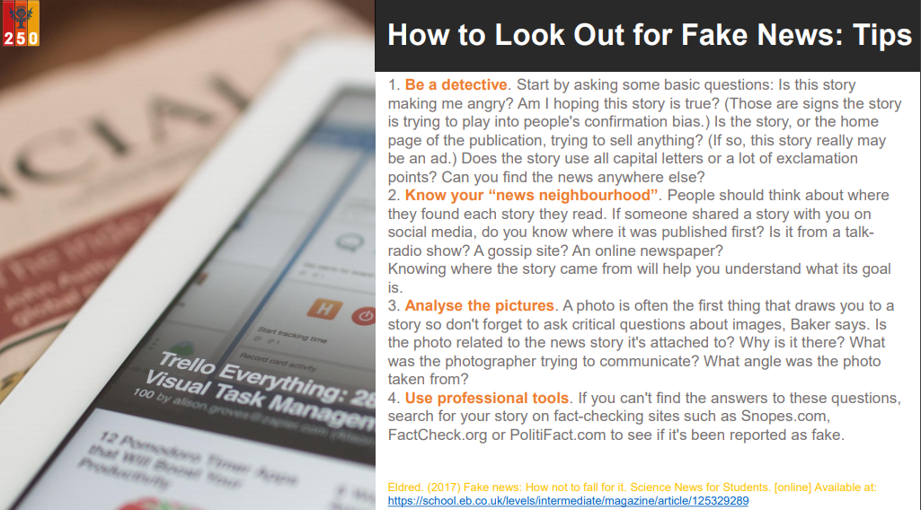

Slide 10
Tasg pump:
Create an information leaflet/poster/video to explain how to determine the reliability of information available to us.
Complete offline (you will need to access resources on our school website)- use the PPt ‘Fake News’ to help you create an information leaflet/ poster on paper explaining what to look out for to avoid being tricked out by ‘fake news’.
Success criteria:
Included the 3 learning objectives - know the meaning of ‘fake news’, understand the importance of the difference, be able to identify fake news
Used the tips from the Britannica ‘Fake News’
Included eye-catching fonts and colours, images, examples to get across the information needed successfully
Plenary: Summarise your Top five tips for spotting ‘Fake news’ and share them with your household.

